Slide 1
Recommending initial target neighborhood for product sales
Harsh Rahamatkar
October 05, 2019

Slide 2
Introduction
Any company who wants to sell a product specific to particular business needs target business venues or locations to send their salesperson where they could find relevant businesses for best response.
For example, a company developed a new much efficient kind of coffee dispenser. So it will need to contact or sell the product to businesses in optimal neighborhoods where most of the coffee shops are available and is sufficiently populated to reduce the transportation cost, increase the number of target shops and increasing the number of consumers directly affected.
Similarly, we can determine these initial target areas for the for other companies with new products.

Slide 3
Data sources
Following data sources will be needed to extract/generate the required information:
demographic data of New York from Kaggle
number of business/venues and their type and location in every neighborhood will be obtained using Foursquare API

Slide 4
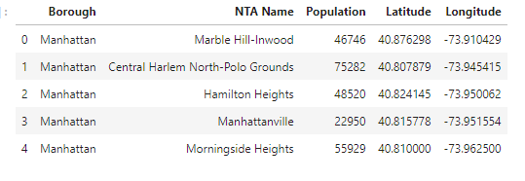
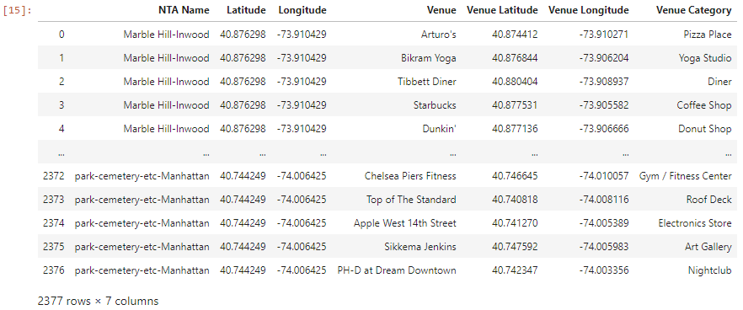
Data after cleaning and feature selection
Neighborhood Population Data
Venues Data

Slide 5

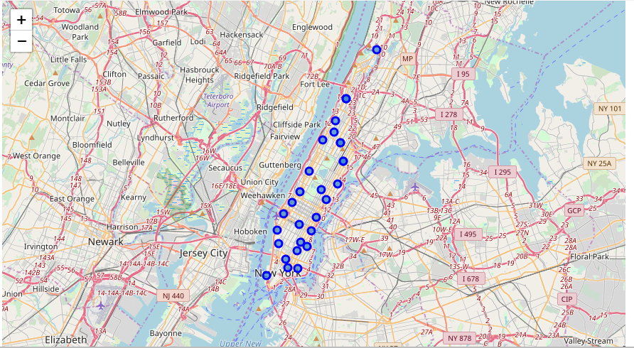
Neighborhoods of Manhattan

Slide 6
Problem
Let’s take the required business as coffee shop (for new efficient coffee dispenser machine), we will require to sell more coffee machine as well as a greater number of people should be influenced.

Slide 7
Methodology
So first, we collect all the neighborhoods with required businesses and create a business score column for them. This score will prefer number of coffee shops over the population of the neighborhood. Thus, we will calculate it as:
business score of the neighborhood = Population x (No. of coffee shops) ^2
So, generalizing this method, business score of neighborhoods for any category of business will be:
business score of the neighborhood = Population x (No. of business of the category) ^2
We then select the top n number of neighborhoods sorted by business score from the list according to requirement n.

Slide 8
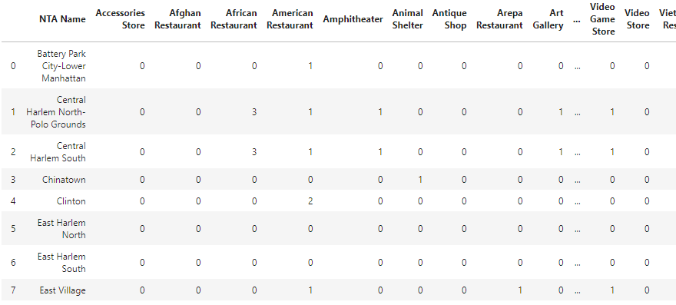
Analysis
Encoded list of neighborhoods with number of different venues category in it

Slide 9
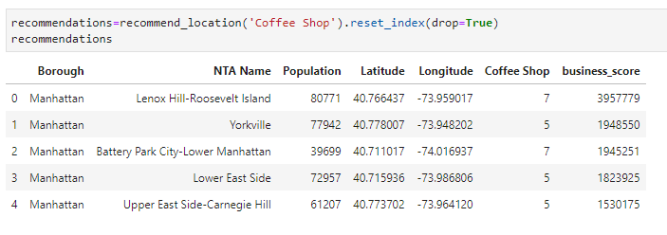
Analysis
Recommended neighborhoods following for coffee shops

Slide 10
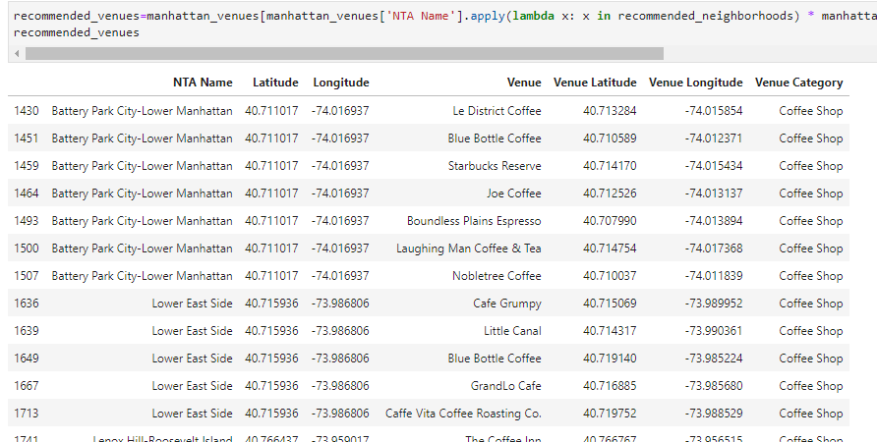
Analysis
List of all the venues in the recommended neighborhoods for coffee shop category

Slide 11
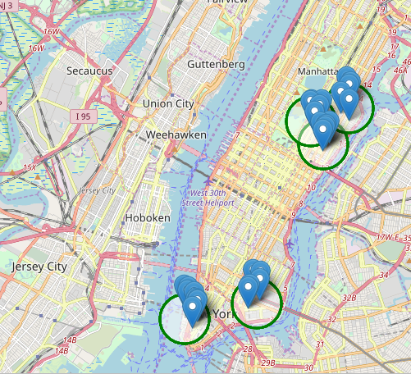
Analysis
Recommended Venue locations for coffee shop category

Slide 12
Results And discussion
So, for the new coffee dispenser machine manufactured by the company, to have large influence on the basis of both number of coffee shops in and the population of the neighborhood, we came to conclusion that Lenox Hill-Roosevelt Island, Yorkville, Battery Park City-Lower Manhattan, Lower East Side and Upper East Side-Carnegie Hill will be the best five.
We can use the same for other categories of businesses like gym, video store, restaurants etc. to get the target locations for initial sales of the good to have wide influence and least transportation costs.

Slide 13
Conclusion
We were required to get the recommendations for initial target neighborhoods for sending the new product manufactured/created by any company for most sales and influence. Following the given methodology of weighted products with population and number of businesses/venues in neighborhood, we successfully got recommendations for a new coffee dispenser machine.

